Slide 1
Week at A Glance for Science
August
22-26
Earth’s Changing Landscape

Slide 2
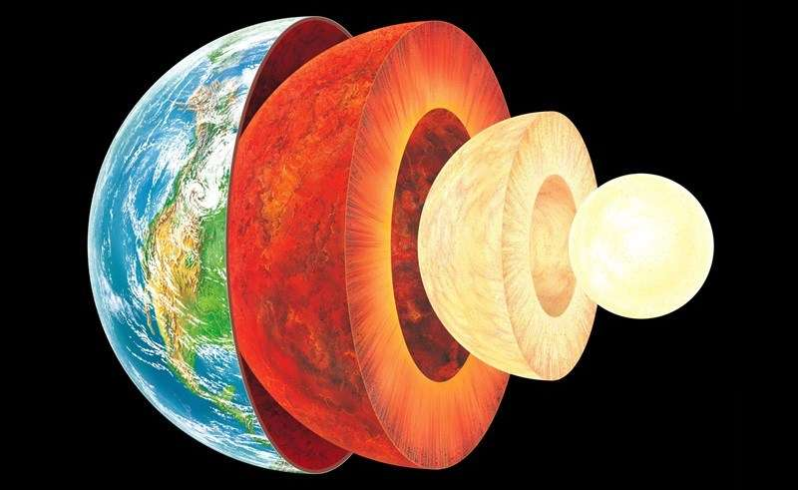

Slide 3
S6E5. Obtain, evaluate, and communicate information to show how Earth’s surface is formed.
Ask questions to compare and contrast the Earth’s crust, mantle, inner and outer core, including temperature, density, thickness, and composition.
c. Construct an explanation of how to classify rocks by their formation and how rocks change through geologic processes in the rock cycle.
f. Construct an explanation of how the movement of lithospheric plates, called plate tectonics, can cause major geologic events such as earthquakes and volcanic eruptions. (Clarification statement: Include convergent, divergent, and transform boundaries.)
Supporting Standards
b. Plan and carry out an investigation of the characteristics of minerals and how minerals contribute to rock composition.
g. Construct an argument using maps and data collected to support a claim of how fossils show evidence of the changing surface and climate of the Earth.

Slide 4
Monday, August 22
Standard: S6E5. a) Ask questions to compare and contrast the Earth’s crust, mantle, inner and outer core, including temperature, density, thickness, and composition.
Learning Target: I can describe Earth’s layers and composition.
Warm-up: Silent Reading (Scholastic Magazine).
Work Session: Direct Instruction; students will take notes and generate questions that lead to compare & contrast of Earth’s layers.
Lab Activity: Convert measurements to smallest units that students can then create models or drawings.
Closing: Think-pair- Share
Reminders: Quiz on Friday

Slide 5
Tuesday, August 23
Standard: S6E5. a) Ask questions to compare and contrast the Earth’s crust, mantle, inner and outer core, including temperature, density, thickness, and composition.
Learning Target: I can describe Earth’s layers and composition.
Warm-up: Silent Reading (Scholastic Magazine)
Work Session: Guided Instruction; students will research using computers; students will work on model.
Lab Activity: Convert measurements to smallest units that students can create models or drawings.
Closing: Ticket Out The Door
Reminders: Quiz 8/26

Slide 6
Wednesday, August 24
Standard: S6E5. a) Ask questions to compare and contrast the Earth’s crust, mantle, inner and outer core, including temperature, density, thickness, and composition.
Learning Target: I can describe Earth’s layers and composition.
Warm-up: “The Rock Cycle”
Work Session: Small group investigations; Board Game; Video
Lab Activity: Explore seismic waves by listening to sounds from different items at home/school (watermelon, tree, etc)
Closing: Class KWL chart
Reminders: Quiz 8/26

Slide 7
Thursday, August 25
Standard: S6E5. a) Ask questions to compare and contrast the Earth’s crust, mantle, inner and outer core, including temperature, density, thickness, and composition.
Learning Target: I can describe Earth’s layers and composition.
Warm-up: Silent Reading (Library Book)
Work Session: Student Present their findings though observations, research, and analysis of instructional activities.
Lab Activity: Focus on temperature and density using scientific tools (triple beam scale, graduated cylinder)
Closing: Class KWL chart
Reminders:

Slide 8
Friday, August 26
Standard: S6E5. a) Ask questions to compare and contrast the Earth’s crust, mantle, inner and outer core, including temperature, density, thickness, and composition.
Learning Target: I can describe Earth’s layers and composition.
Warm-up: Family Feud “Earth’s Layers” edition.
Work Session: Family Feud “Earth’s Layers” edition; Board game, Quiz (Earth’s Layers)
Lab Activity: “egg float” or “paper type, flaps, or design”
Closing: Journal Writing and Questions I still have…
Reminders: Quiz 8/26

Slide 9
Resources for Unit 1 A
What are the Layers of Earth?
Layers of the Earth
Layers of the Earth – Geology –
The Good and the Beautiful Home school Science 8:47
7 Ways We Know What’s Inside the Earth - SciShow 12:08
An Overview of Earth’s Layers - 10:07

Slide 10
S6E5. Obtain, evaluate, and communicate information to show how Earth’s surface is formed.
Ask questions to compare and contrast the Earth’s crust, mantle, inner and outer core, including temperature, density, thickness, and composition.
Plan and carry out an investigation of the characteristics of minerals and how minerals contribute to rock composition.
Construct an explanation of how to classify rocks by their formation and how rocks change through geologic processes in the rock cycle.
Ask questions to identify types of weathering, agents of erosion and transportation, and environments of deposition. (Clarification statement: Environments of deposition include deltas, barrier islands, beaches, marshes, and rivers.)
Develop a model to demonstrate how natural processes (weathering, erosion, and deposition) and human activity change rocks and the surface of the Earth.
Construct an explanation of how the movement of lithospheric plates, called plate tectonics, can cause major geologic events such as earthquakes and volcanic eruptions. (Clarification statement: Include convergent, divergent, and transform boundaries.)
Construct an argument using maps and data collected to support a claim of how fossils show evidence of the changing surface and climate of the Earth.
Plan and carry out an investigation to provide evidence that soil is composed of layers of weathered rocks and decomposed organic material.

